Slide 1


Slide 2
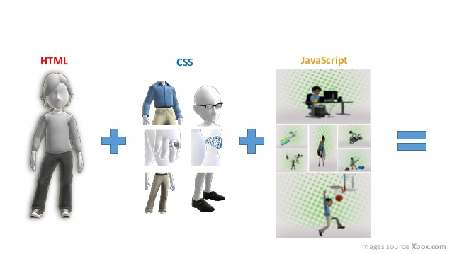

Slide 3
THINK……
What we cant do with HTML and CSS?

Slide 4
Can’t use Variables.
Can’t work with Control Statements like if-else,loops etc
Can’t create Dynamics Effects to our web pages.
Can’t display Messages like “Do you want to delete?” on our web pages.
Can’t create Database to store our data.
Can’t Embed with other scripting languages.

Slide 5

JavaScript was designed to add interactivity to HTML pages
JavaScript is a scripting language
A scripting language is a lightweight programming language.
JavaScript is usually embedded directly into HTML pages.
JavaScript is an interpreted language (means that scripts execute without preliminary compilation).
Everyone can use JavaScript without purchasing a license.

Slide 6

JavaScript gives HTML designers a programming tool
JavaScript can put dynamic text into an HTML page.
JavaScript can read and write HTML elements - A JavaScript can read and change the content of an HTML element

Slide 7
Where JavaScript is used??
JavaScript is used to create interactive websites. It is mainly used for:
Client-side validation
Dynamic drop-down menus
Displaying data and time
Displaying popup windows and dialog boxes (like alert dialog box, confirm dialog box and prompt dialog box)
Displaying clocks etc.

Slide 8

<html>
<body>
<h1>My First Web Page</h1>
<script type="text/javascript">
document.write("<p>" + Date() + "</p>“)
</script>
</body>
</html>

Slide 9

<html>
<head>
<script type="text/javascript" src="xxx.js"></script>
</head>
<body>
</body>
</html>

Slide 10
JavaScript can also be placed in external files.
External JavaScript files often contains code to be used on several different web pages.
External JavaScript files have the file extension .js

Slide 11

<html>
<body>
<p>paragraph 1</p>
<script type="text/javascript">
document.bgColor="blue";
alert("first script block");
</script>
<p>paragraph 2</p>
<script type="text/javascript">
document.bgColor="red";
alert("second script block");

Slide 12
</script>
<p>paragraph 3</p>
<script type="text/javascript">
document.bgColor="green";
alert("third script block");
</script>
</body>
</html>
A html page

Slide 13

Document.write:For printing some text on the page. All html tags can also be used in this case.
Document.bgColor:which changes the color of the page.
Alert:which display a message box.
  window.alert("sometext")
Prompt:which ask the user to input some value.
  window.confirm("sometext");
Confirm:it ask the user for confirming the values input.
  window.prompt("sometext","defaultvalue");

Slide 14

Numeric data
Text data
Boolean data

Slide 15

A variable can have a short name, like x, or a more descriptive name, like carname.
Rules for JavaScript variable names:
Variable names are case sensitive (y and Y are two different variables)
Variable names must begin with a letter or the underscore character
Variable can also begin with _ and $.
  Eg: var x = 3.14
  Var y=“Hello”.
  Var y=“hello”, x=3.14;

Slide 16
Variables
While naming your variables in JavaScript, keep the following rules in mind.
You should not use any of the JavaScript reserved keywords as a variable name. These keywords are mentioned in the next section. For example, break or boolean variable names are not valid.
JavaScript variable names should not start with a numeral (0-9). They must begin with a letter or an underscore character. For example, 123test is an invalid variable name but _123test is a valid one.

Slide 17
JavaScript variable names are case-sensitive. For example, Name and name are two different variables.

Slide 18
var x;
var carname;
<html>
<body>
<script type="text/javascript">
var myfirst;
myfirst="hello";
alert(myfirst);
myfirst=1234
alert(myfirst);
</script>
</body>
</html>

Slide 19
Arithmetic Operators
Operator | Description | Example | Result
+ | Addition | x=2 | 4
 |  | y=2
 |  | x+y
- | Subtraction | x=5 | 3
 |  | y=2
 |  | x-y
* | Multiplication | x=5 | 20
 |  | y=4
 |  | x*y
/ | Division | 15/5 | 3
 |  | 5/2 | 2,5
% | Modulus (division remainder) | 5%2 | 1
 |  | 10%8 | 2
 |  | 10%2 | 0
++ | Increment | x=5 | x=6
 |  | x++
-- | Decrement | x=5 | x=4
 |  | x--

Slide 20
Assignment Operators
Operator | Example | Is The Same As
= | x=y | x=y
+= | x+=y | x=x+y
-= | x-=y | x=x-y
*= | x*=y | x=x*y
/= | x/=y | x=x/y
%= | x%=y | x=x%y

Slide 21
Comparison Operators
Operator | Description | Example
== | is equal to | 5==8 returns false
=== | is equal to (checks for both value and type) | x=5
 |  | y="5"
 |  | x==y returns true
 |  | x===y returns false
!= | is not equal | 5!=8 returns true
> | is greater than | 5>8 returns false
< | is less than | 5<8 returns true
>= | is greater than or equal to | 5>=8 returns false
<= | is less than or equal to | 5<=8 returns true

Slide 22
Logical Operators
Operator | Description | Example
&& | and | x=6
 |  | y=3
 |  | (x < 10 && y > 1) returns true
|| | or | x=6
 |  | y=3
 |  | (x==5 || y==5) returns false
! | not | x=6
 |  | y=3
 |  | !(x==y) returns true

Slide 23
Basic Examples
<script>
x=3
y=20*x+12
alert(y)
</script>
<script>
s1=12
s2=28
s=s1+s2
document.write(“output is"+s)
</script>

Slide 24
External Javascript
<html>
<head>
<script type="text/javascript" src="jjj.js"></script>
</head>
<body>
<p>here is the javascript used</p>
</body>
</html>

Slide 25

var a=prompt("enter the temperature in degree farenheit");
var b;
b=5/9*(a-32)
alert(b);
document.write(b);

Slide 26
Changing inner HTML
document.getElementById(“aa”).innerHTML= “Hello”.

Slide 27
<html>
<head>
<script>
function changeLink()
{
document.getElementById('myAnchor').innerHTML="W3Schools";
document.getElementById('myAnchor').href="http://www.w3schools.com";
document.getElementById('myAnchor').target="_blank";
}
</script>
</head>

Slide 28
<body>
<a id="myAnchor" href="http://www.microsoft.com">Microsoft</a>
<input type="button" onclick="changeLink()" value="Change link">
</body>
</html>

Slide 29

Write a JavaScript code that display the numbers on the page and then display the division of numbers on the page as well in the alert box.
Write a JavaScript code that accepts the name from the user and concatenate the name with the string and display on page as well in the alert box.
Write a external JavaScript that inputs the temperature in Fahrenheit and output the temperature in degree celsius in alert box and on page the page as well.

